Slide 1

.
TIC MODULE:
Work prepared by:
Sofiane HAMAIDI
Rafie BAZINE
Yacine GHERBI
Kahina SLIMANI
.
L1 SIGL, USTHB 31 december 2023

Slide 2
Content Table
What is TIC?
Microsoft Technologies
PowerPoint
Excel
Alternatives
LaTex
Comparison between Microsoft word and Latex:
Html & CSS
Git & GitHub
Git
GitHub

Slide 3
What is TIC?
TIC is and abbreviation of “ Information and Communication Technologies ”.
This Module teaches us the fundamentals of office works and technologies such us Word and excel and PowerPoint, and also the fundamentals of web development which are HTML & CSS and the essentials of collaborative work with Git & GitHub.
Our professor in this module is:
Mr. Redouane BOUCHEKIR

Slide 4

Microsoft Technologies
WORD:
Microsoft Word, a pivotal word processing tool by Microsoft since 1983, is essential for document creation and editing. Its key features include extensive formatting options, pre-designed templates, real-time collaboration tools, and robust review functions, catering to diverse document needs.

Slide 5
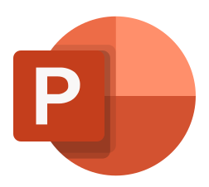
PowerPoint:
Microsoft PowerPoint, launched in 1987, revolutionized presentations by organizing content into visually appealing slides. It offers pre-designed themes, animations, multimedia integration, and a presenter view, making presentations engaging for business, education, and various communication needs.

Slide 6
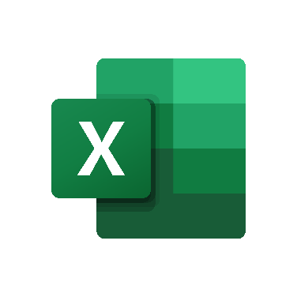
EXCEL:
Microsoft Excel, introduced in 1985, is a robust spreadsheet program initially for Macintosh, later for Windows. It's renowned for data organization and analysis, offering grids, formulas, charts, data manipulation, and collaboration tools, essential for tasks from budgeting to collaborative project tracking.

Slide 7
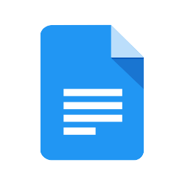
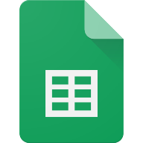

Alternatives:
Google Workspace tools: Sheets, Docs, Slides.
WPS office.
Libre office

Slide 8

LaTex :
LaTeX, developed by Leslie Lamport in the 1980s, is a typesetting system widely used in academia and science. It's renowned for high-quality document formatting, especially in technical fields. With strong support for mathematical equations, efficient document handling, seamless Git integration, and a robust community offering various functional packages, LaTeX excels in precise and structured document preparation, particularly for scientific content.

Slide 9
Comparison between Microsoft word and Latex:
Feature | LaTeX | Word
Typesetting | Superior typesetting for technical documents | Standard typesetting for general use
User Interface | Markup-based, may require coding skills | What You See Is What You Get
Document Structure | Structured with commands and environments | Linear structure with sections and styles
Math Support | Excellent for mathematical notation | Good, but LaTeX excels in complex math
Collaboration | Challenging for non-LaTeX users | Seamless collaboration, track changes
Customization | Highly customizable | Customizable with templates and styles
Version Control | May integrate with Git easily | Limited version control capabilities
Cost | Open-source and free | Part of Microsoft Office, subscription-based

Slide 10
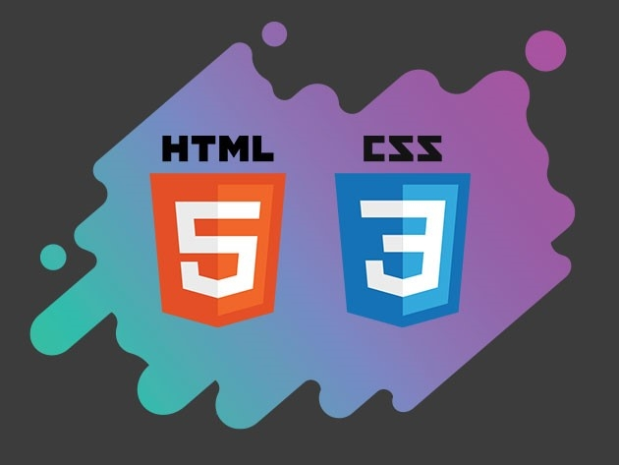
Html & CSS
HTML (Hypertext Markup Language) and CSS (Cascading Style Sheets) are foundational to web development. HTML structures web pages, defining elements and enabling links and multimedia embedding, while CSS separates presentation from content. Together, they provide markup, links, multimedia support, style definition, layout control, and responsive design for a consistent web experience.

Slide 11
GIT& GitHub
Git:
Git, created by Linus Torvalds in 2005, revolutionized source code management as a distributed version control system. It tracks changes, supports branching, commits, and merging, enabling parallel development and ensuring code integrity and collaboration in software development.

Slide 12

Github:
GitHub, founded in 2008, serves as a collaborative platform for hosting Git repositories. It extends Git's capabilities by offering repository hosting, collaboration tools, code review features, and integration with CI/CD tools. Known for its user-friendly interface and support for social coding, GitHub is a central hub for open-source projects, enabling seamless collaboration and code contribution.

Slide 13
Thank you

